Slide 1
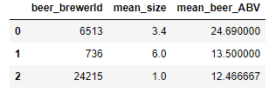
1. Rank top 3 Breweries which produce the strongest beers?

Slide 2
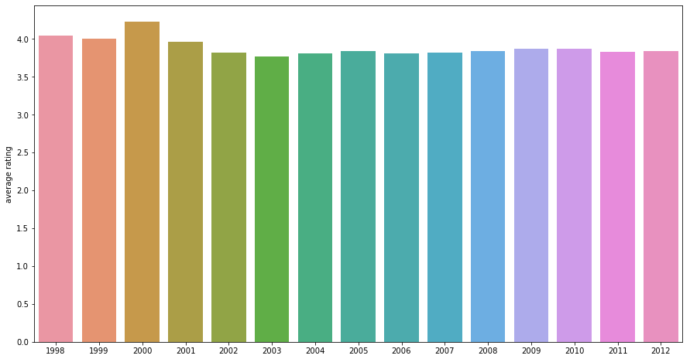
2. Which year did beers enjoy the highest ratings?

Slide 3
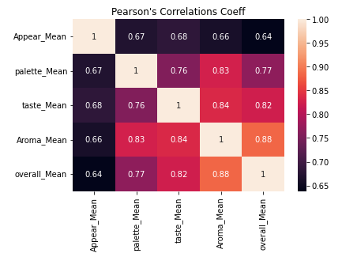
3. Based on the user’s ratings which factors are important among taste, aroma, appearance, and palette?

Slide 4
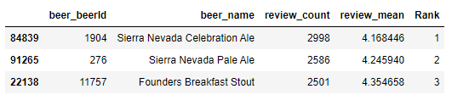
4. If you were to recommend 3 beers to your friends based on this data which ones will you recommend?

Slide 5
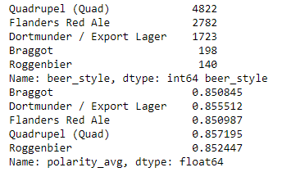
5. Which Beer style seems to be the favorite based on reviews written by users?

Slide 6
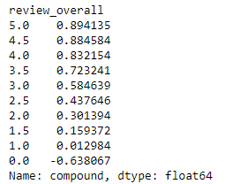
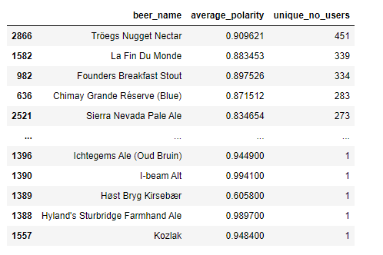
6. How does written review compare to overall review score for the beer styles?

Slide 7
7. How do find similar beer drinkers by using written reviews only?

